Slide 1
Apply access controls to database
Presented by – Harshal Sawant - A20538827
Pratik Darade-A20536376
Ishan Prabhune - A20538828
Raj Dedhia - A20551543
Aniket Singh - A20546525

Slide 2
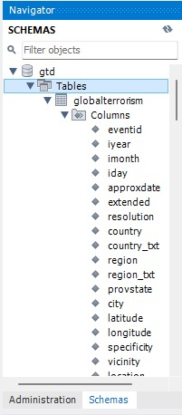
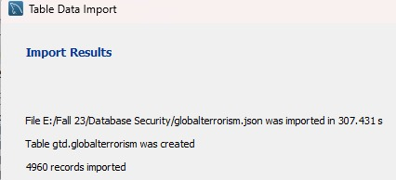
2. Successfully imported the database.
In this step, I downloaded the database from the specified source (provide the source link) and successfully imported it into MySQL Workbench.
The imported database contains essential data that we will secure and manage.
Importing the database is a critical initial step in setting up our security measures, as it provides the foundation on which we will apply access controls.

Slide 3
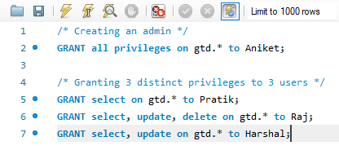
3. Separation of duties intro (AC-5)
SoD divides responsibilities and access rights among multiple roles or users to prevent any single individual from having too much control or authority.
It reduces the likelihood of fraud, errors, and misuse of data.
SoD can be achieved by assigning distinct privileges and roles to different individuals or teams within an organization.
It is particularly important in scenarios where sensitive data or critical systems are involved, as it minimizes the risk of unauthorized access.
SoD can help organizations comply with various security standards and regulations, such as NIST guidelines.

Slide 4
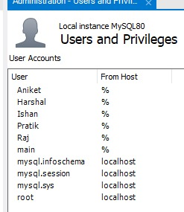
4. Created 4 roles and distributed diff privileges to each of them so that implementation of ac-5 is displayed.
Key Points for Role Creation and Privilege Distribution:
Created four roles: Administration, User1, User2, and User3.
Administration role typically has elevated privileges, such as creating tables, managing users, and modifying database schemas.
User1, User2, and User3 roles have distinct but more limited privileges, focusing on data access, modification, or specific tasks.
Role-based access control (RBAC) is a crucial part of AC-5, as it enforces restrictions on who can perform what actions in the database.
RBAC ensures that individuals only have access to the database functions and data that are necessary for their roles and responsibilities.
By distributing privileges this way, you are reducing the risk of unauthorized access and enforcing the Separation of Duties principle.
Insert Query Image Here
Include an image of a sample query or role creation in MySQL Workbench to illustrate the actual implementation.

Slide 5
5. created 4 users. main is the admin so he has all the privileges
Key Points for User Creation and Privilege Assignment:
Created four users: Admin (Main), User1, User2, and User3.
The Admin (Main) user has been assigned all administrative privileges, allowing full control over the database.
User1, User2, and User3 have been assigned limited privileges based on their respective roles to adhere to the Separation of Duties principle.
Privileges may include SELECT, INSERT, UPDATE, DELETE, and other relevant actions based on the roles.
This assignment of privileges ensures that users can perform their designated tasks without unnecessary access to sensitive functions.
The main admin user plays a critical role in managing the database and overseeing user activities.
Insert Main Image Here
Include an image or screenshot of MySQL Workbench or a relevant query showing the main admin user's privileges for visual representation.

Slide 6
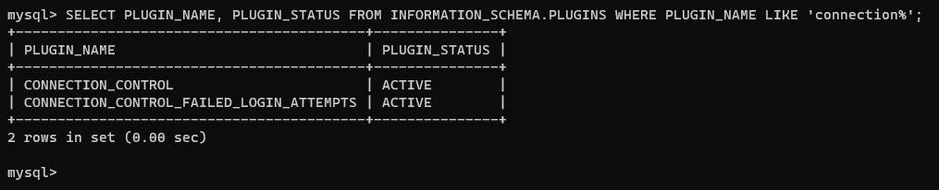
6. Implemented ac-7
Key Points for AC-7 Implementation:
AC-7 is a critical security control that helps monitor and restrict unsuccessful logon attempts to prevent unauthorized access.
Display an image where the status shows "active" to indicate that the control has been successfully enabled.
Describe the technical steps you took to implement AC-7 within MySQL Workbench, if applicable.
If MySQL Workbench doesn't provide a built-in feature for this control, explain the alternative method you proposed and how it would be implemented.
Emphasize the importance of this control in enhancing database security and preventing potential threats.
Insert AC-7 Status Image Here
Include an image or screenshot showing the status of AC-7 as "active" within MySQL Workbench or the security settings.

